Slide 1
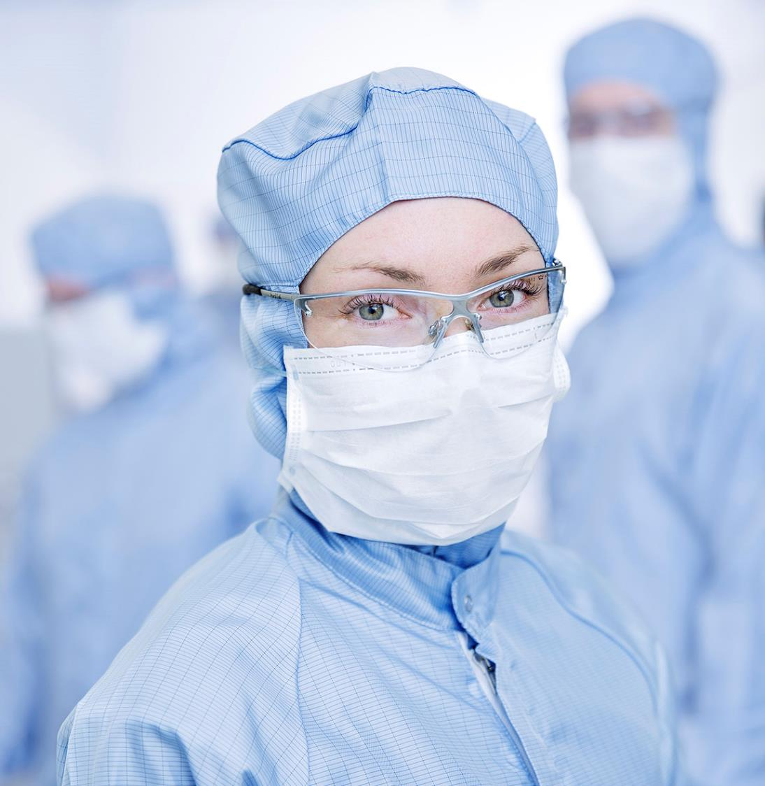
Lithographies experts group
Meeting of pilots group C2N-LAAS
Nathalie Bardou, Pierre-François Calmon, Edmond Cambril, Franck Carcenac, Jean-René Coudevylle, Hugues Granier, Adrian Laborde, Jean-Louis leclercq, Laurent Mazenq…

Slide 2
Online workshop
March 14th
10:00 (CET) Welcome – presentation of the actions in 2024 :
Schedule of the videoconferences in 2024
Processes comparison
Meeting in Toulouse France (Planning proposal October 16-17th, to be confirmed at the meeting)
10:10 Supplier technical presentation
10:10 Kloe Nicolas Brillouet technical presentation title
10:30 Raith Dr. Kahraman Keskinbora From Nanoscale Precision to Ultra-Thick Grayscale Resist Processing: Pioneering Advances in Single and Multibeam LBL
10:50 Quantum Design Prof. Russel Cowburn
11:10 Technical highlights
11:10 Orjan Vallin et Rimantas Brucas (myfab Sweden) : visit in LAAS Toulouse on laser lithography (Kloe system) in Sept-2023, 2 days : S1813 Shipley and 200µm SU8 process developments on Dilase 750
11:30 Bastien Venzac (LAAS)
11:50 Ausrine Bastasyte (Femto) : initiatives Traing group / Lithography, Moodle (formation, forum & databases)
12:05 Radim Zahradnicek Microwriter ML3 Baby first results
12:15 Discussions about subjects of interest (call for topics of interest), examples :
Equipments projects in the field
Feedback from suppliers (Lifetime spare parts, Upgrades,…)
Large volume 3D structures
Good practices , energy saving, eco-sustainability, materials
12: 30 End of the meeting

Slide 3
Thank you for attention!

